Slide 1
VProvide
By: Lakshmi Pendyala
Sahithi Poladi
Hyndavi Velineni
Vatsal Thakkar

Slide 2
Objective
To develop a web application.
Customers can find different service providers according to their requirements either for business or personal use.
Application will let service providers take their business online and helps small-scale businesses to get work.

Slide 3
Product Backlog
ID | STORY | PRIORITY | ESTIMATION | STATUS
1 | As an administrator, I want to create database tables for storing information about customers, service providers, categories of services and payments. | 1 | 7 | Completed
2 | As a new customer, I want to Register for accessing the services. | 2 | 1 | Completed
3 | As a customer, I want to Log In and take up a service. | 3 | 1 | Completed
4 | As a customer, I want to select a category either in Home, Community or Contracts. | 4 | 1 | Completed
5 | As a customer, I want to choose to a sub category like plumbing, gardening and so on. | 5 | 3 | Completed
6 | As a customer, I want to choose a service provider and schedule time to get my work accomplished. | 6 | 7 | Completed
7 | As a service provider, I want to Register to do service and promote my business. | 2 | 1 | Completed

Slide 4
Use Cases Implemented
Customer/Service Provider Registration
Customer/Service Provider Login
Customer Search Service

Slide 5
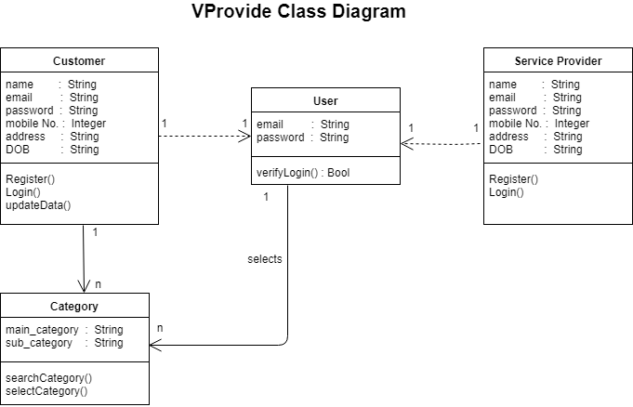
UML Class Diagrams

Slide 6
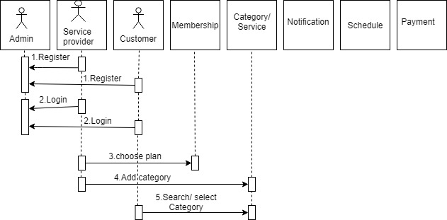
Sequence Diagram

Slide 7
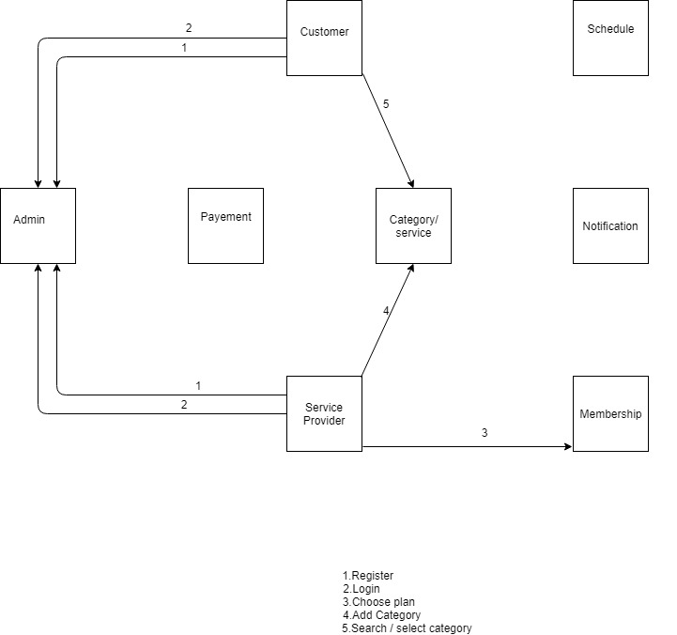
Communication Diagram

Slide 8



Tools Used

Slide 9
Success Scenario
Customer will register to become a member of VProvide.
Service Provide will register to become either an annual member or non-member of VProvide.
Customer will login to find his/her desired service by searching all the categories and sub-categories.

Slide 10
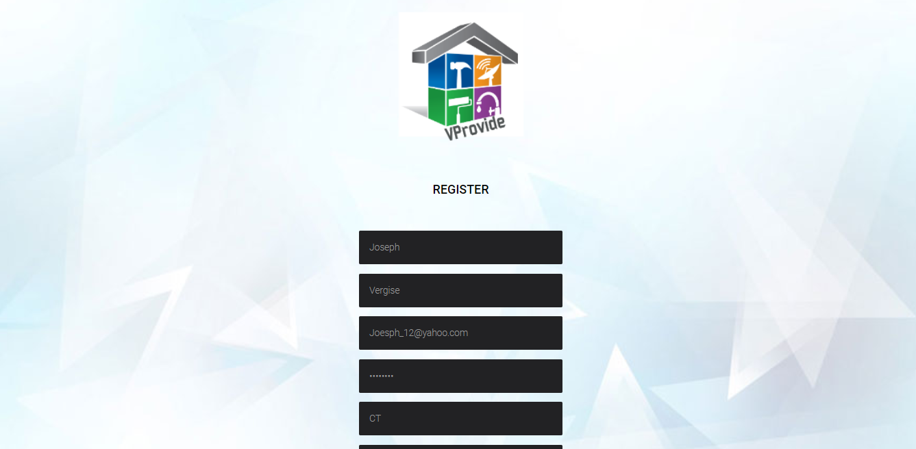
Customer Registration

Slide 11
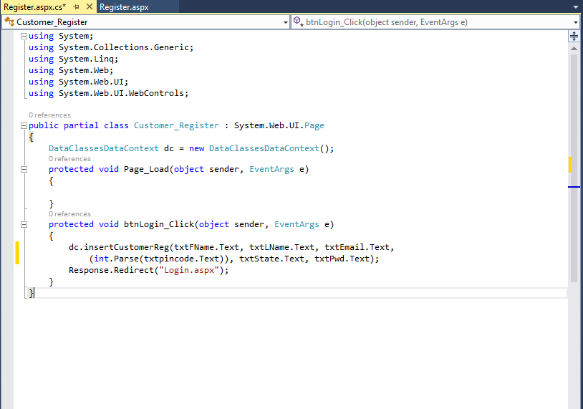
Code

Slide 12
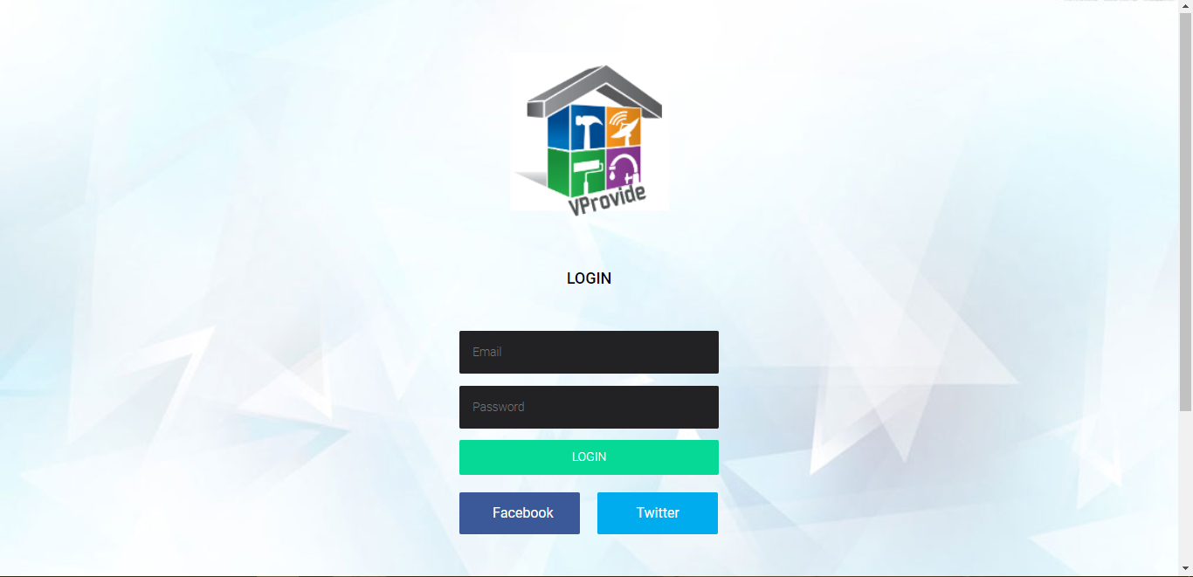
Login

Slide 13
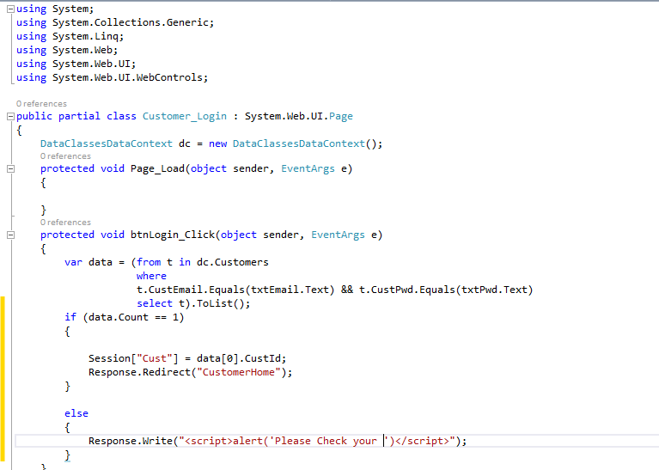
Login Code

Slide 14
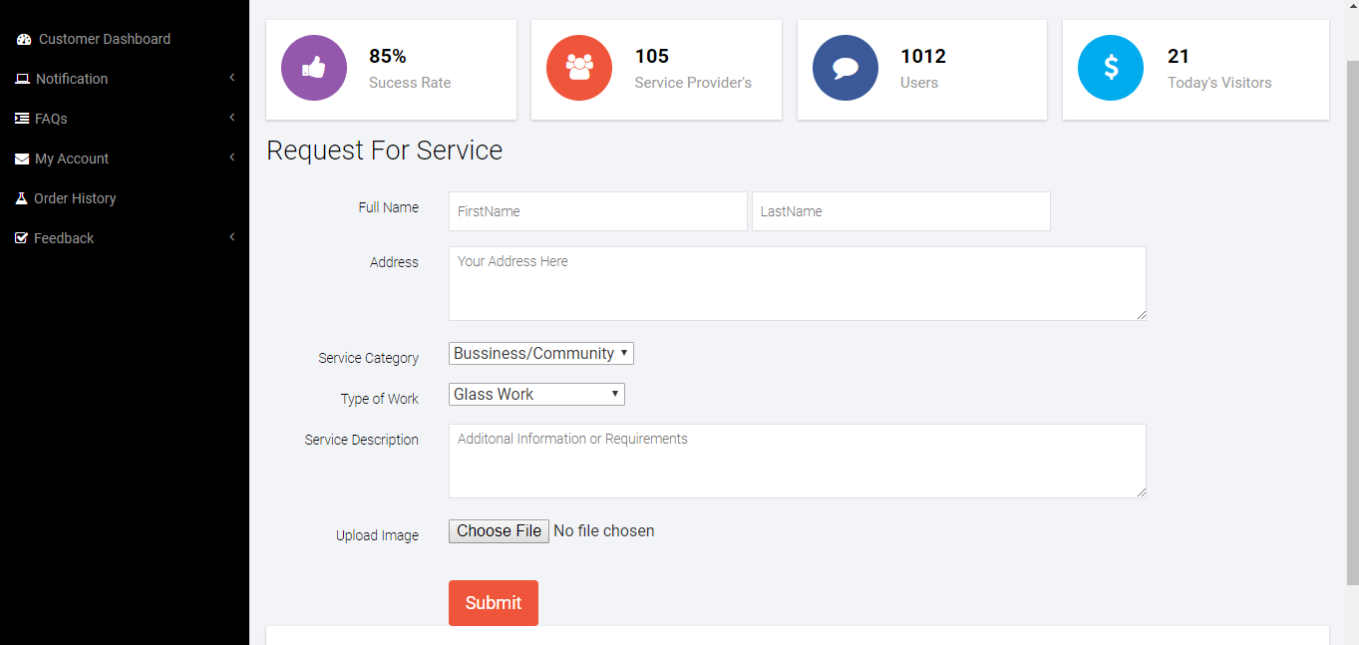
Customer Request For Service

Slide 15
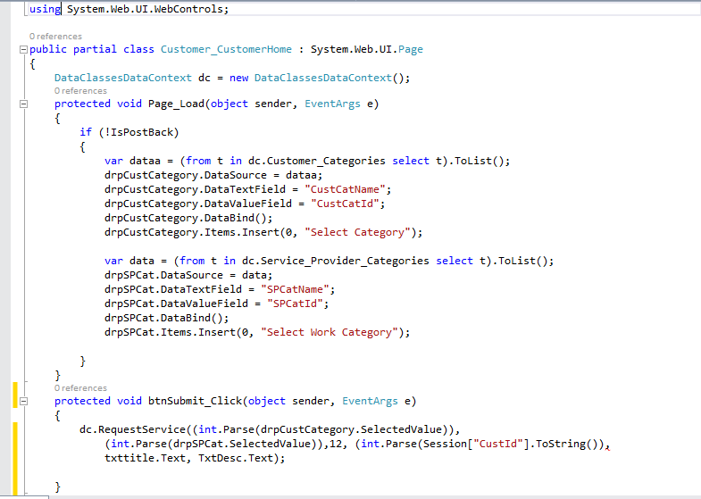
Code

Slide 16
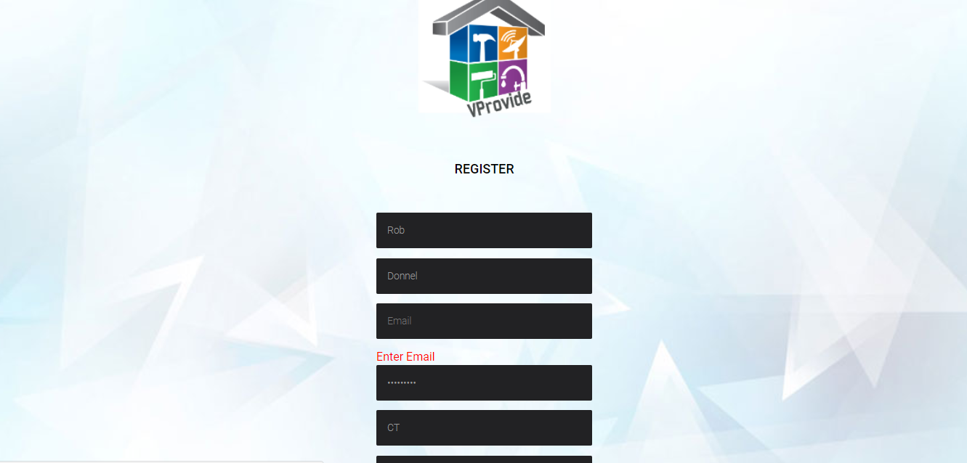
Test Cases
Test Case 1
Test Case Name: In customer/service provider registration, invalid details or null
Description: If data is null, will show error message, display alert
Output: Display validation Controller message in browser “Enter Email”

Slide 17
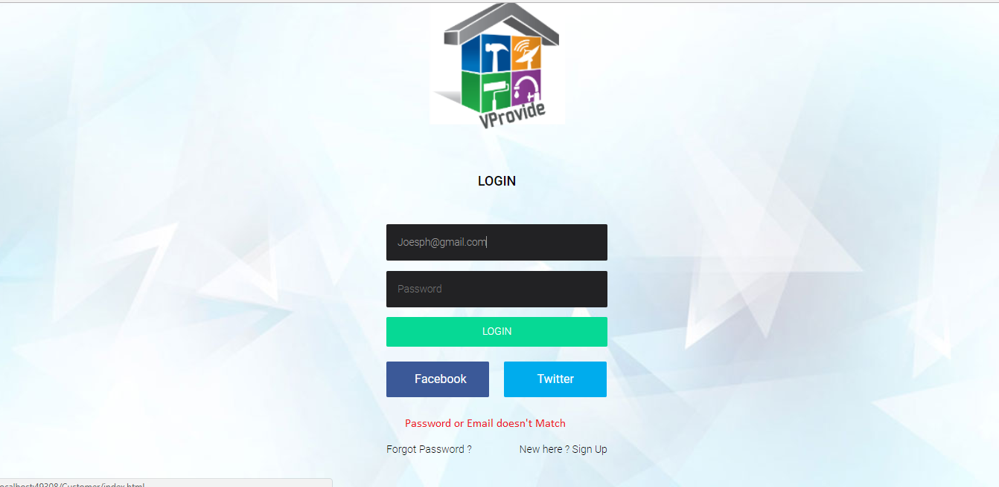
Test Cases
Test Case 2
Test Case Name: In customer/service provider login, verify entered UserID
Description: If incorrect, enter UserID, display alert box
Output: Display alert box in browser “Password or Email doesn’t Match”

Slide 18
Test Cases
Test Case 3
Test Case Name: In customer/service provider login, verify entered password
Description: If incorrect, enter password, click on login button, display alert box
Output: Display alert box in browser “Password or Email doesn’t Match”

Slide 19
Lessons Learned
Vision Statement creation and implementation
Product Backlog creation and implementation
Use Case creation and implementation
Class Diagram creation and implementation
Interaction Diagram creation and implementation

Slide 20
Any questions?

Slide 21
Thank you!

